Slide 1
UNIVERSITY OF TUNIS EL MANAR
FACULTY OF SCIENCES OF TUNIS
DEPARTEMENT OF GEOLOGY
Key Figures:
Tectonic Evolution and Depositional system of the Mesozoic Section in Browse Basin, North Shelf Australia
Jassem GACHA
Sedimentary Basin and Petroleum
Geology Laboratory
Geodynamic, Geomaterials and Geodigital Laboratory (Lab3G)

Slide 2
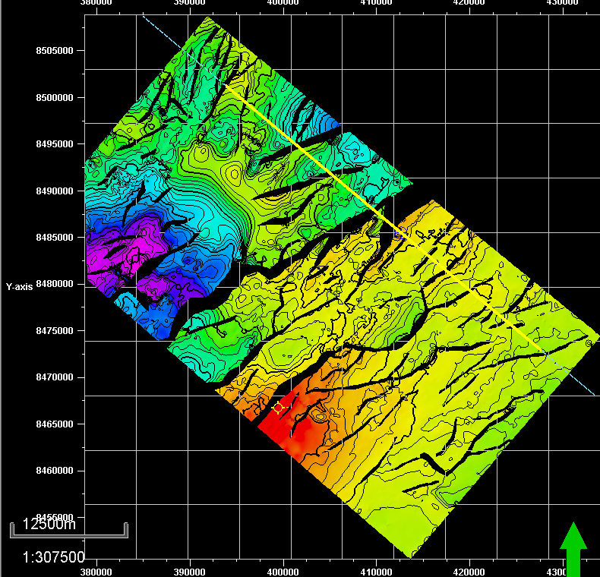
Mega sequence subdivision
SE
SE
Top Syn-Rift
Mega-Sequence
Fig: Mega sequence subdivision, Seismic inline 2411.
Intra-Jurassic
structural map

Slide 3
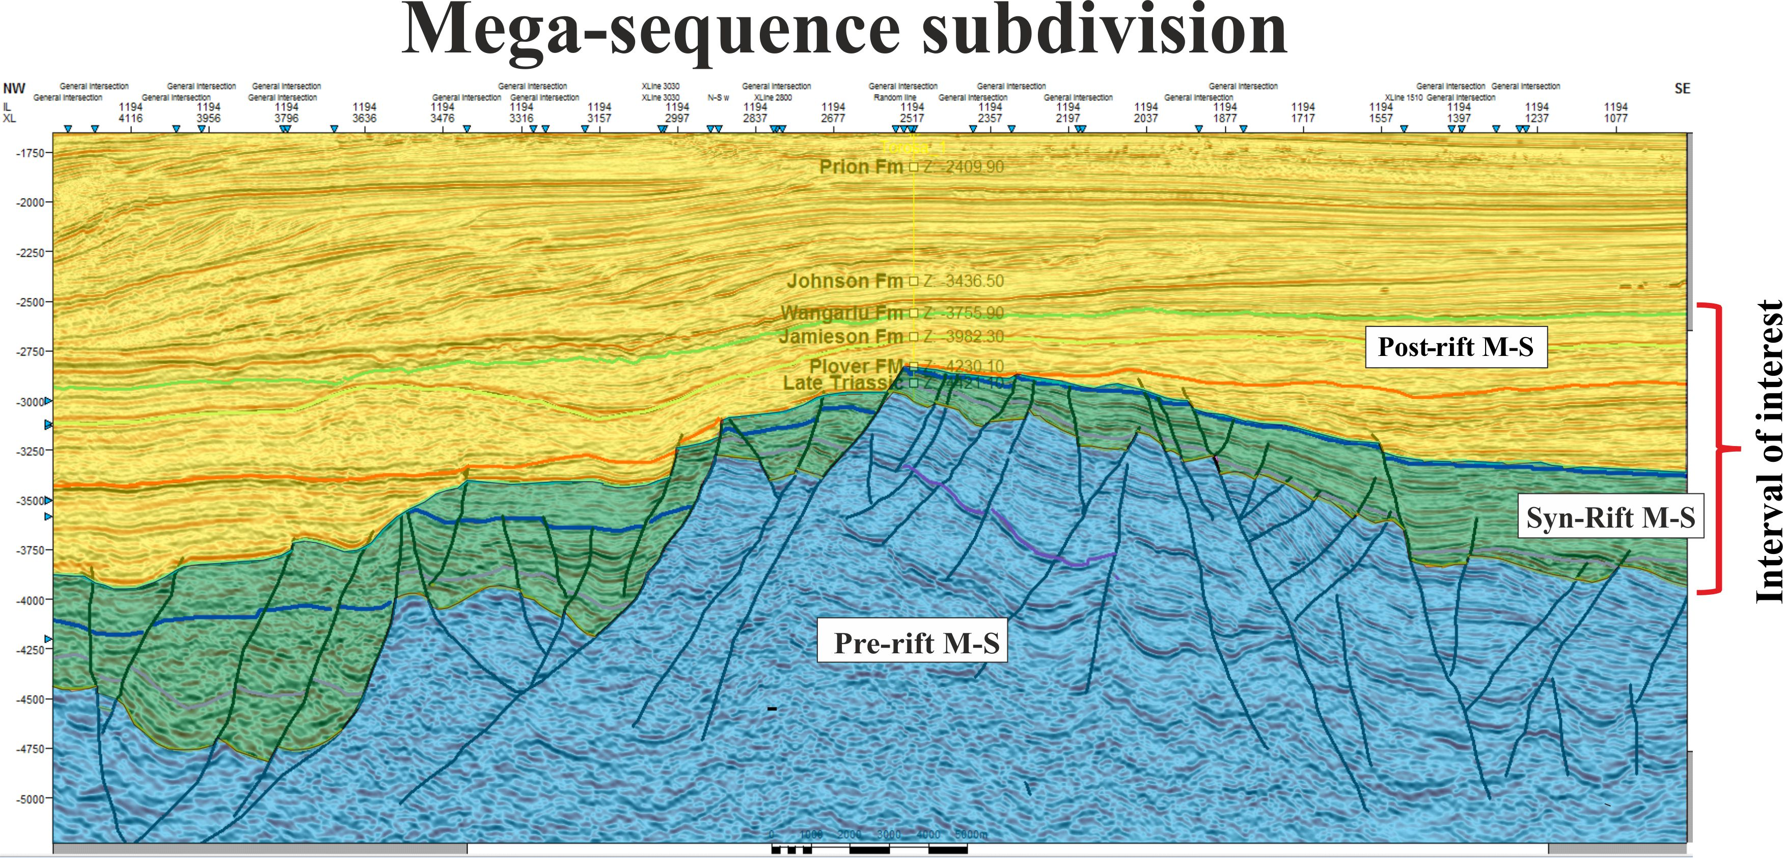
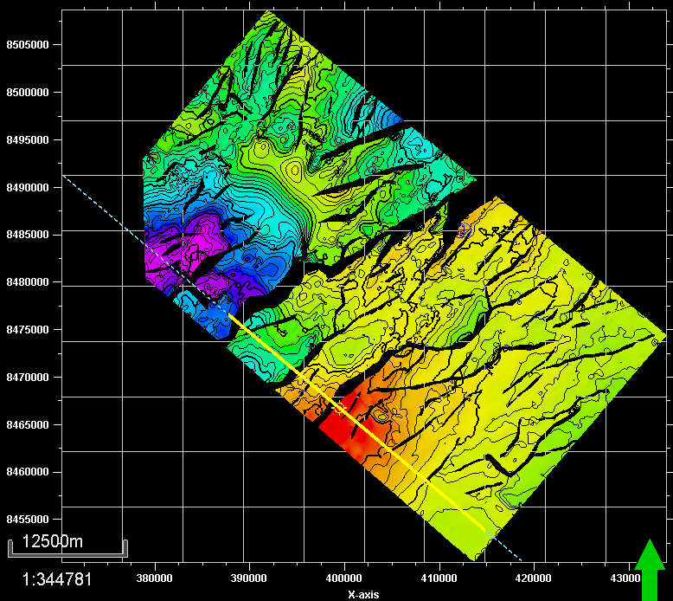
Aptian-Albian
Top Syn-Rift
Mega-Sequence
Top M. Jurassic
Intra-Jurassic
structural map
Fig: Mega sequence subdivision, Seismic inline 1194.
Notes:
We took another line in the southern part for the survey in objective to determine if the mega sequence will be the same or defferent, in this one we did the same thing we have subdivided the seismic line in 3 packedges.but When we were doing this we have problem.

Slide 4
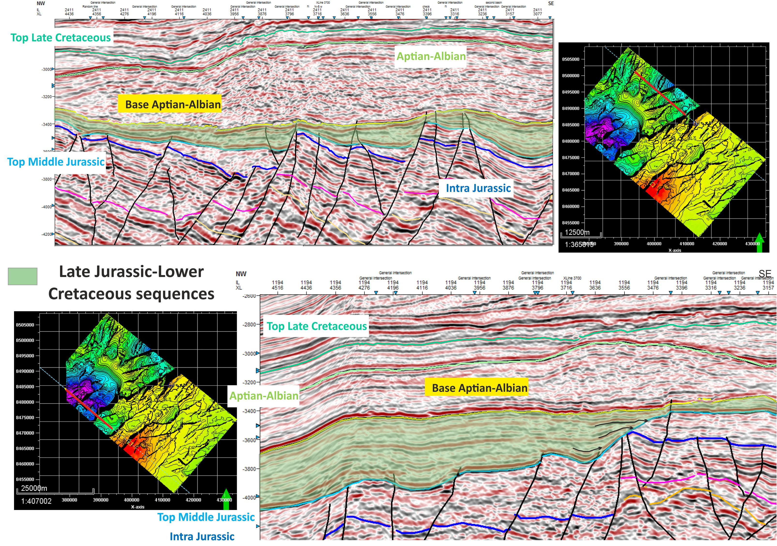
Mega sequence subdivision
Inline 2411
Inline 2411
Intra-Jurassic
structural map
Inline 1194
Inline 1194

Slide 5
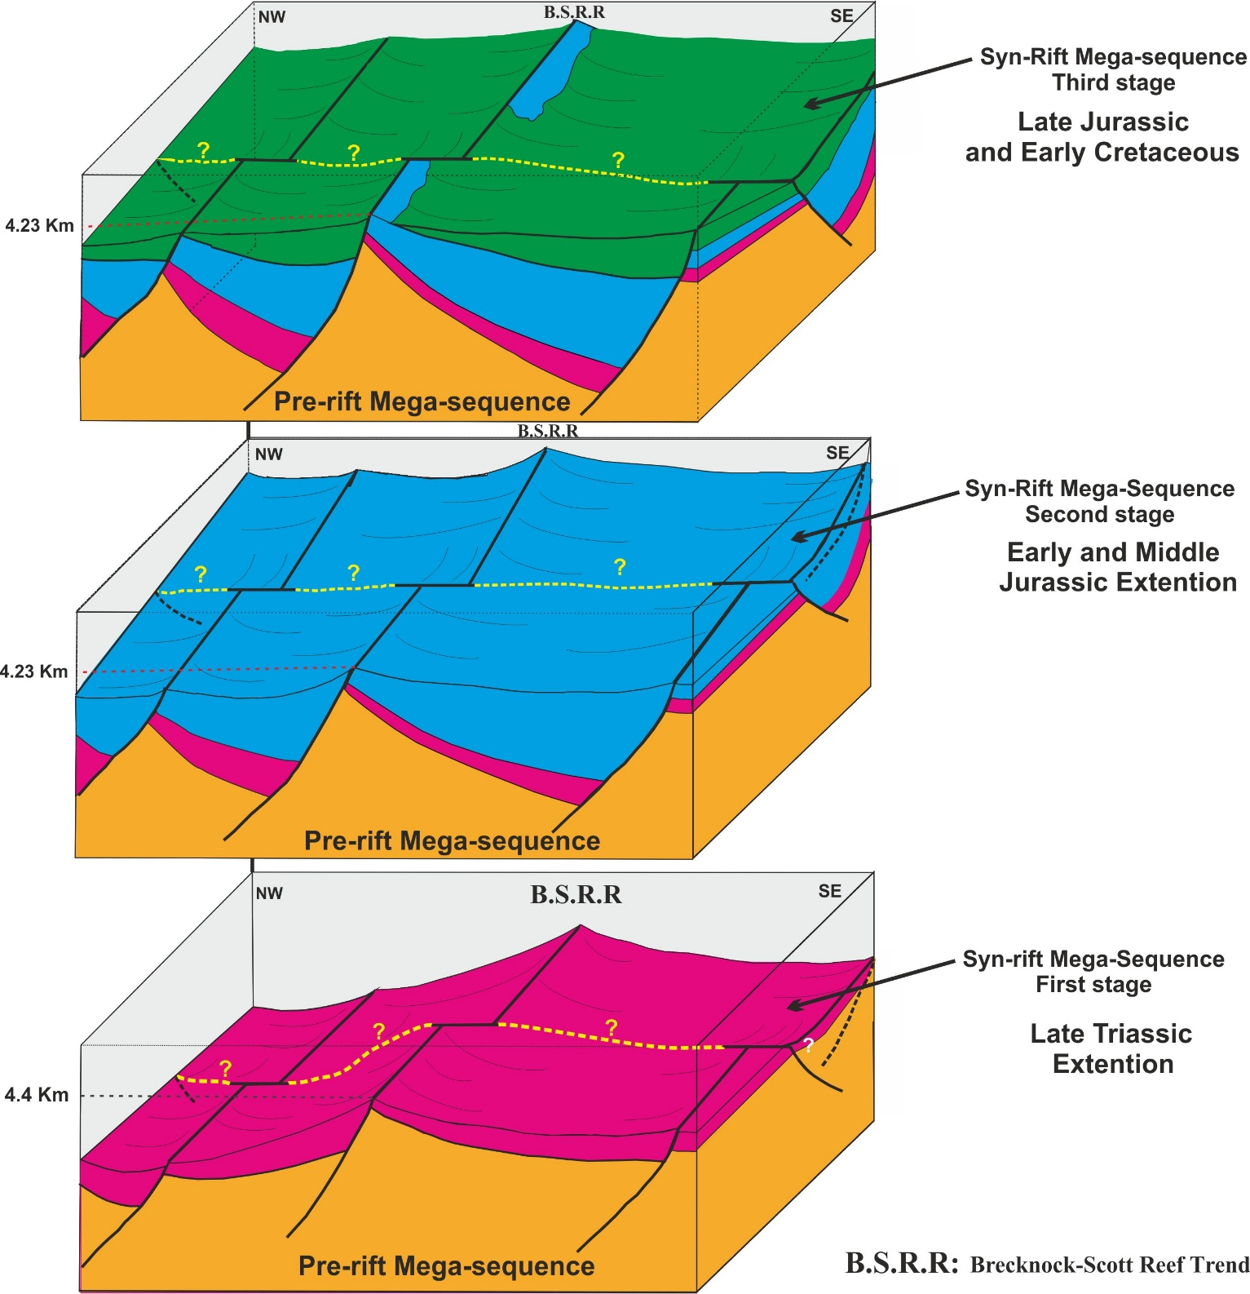
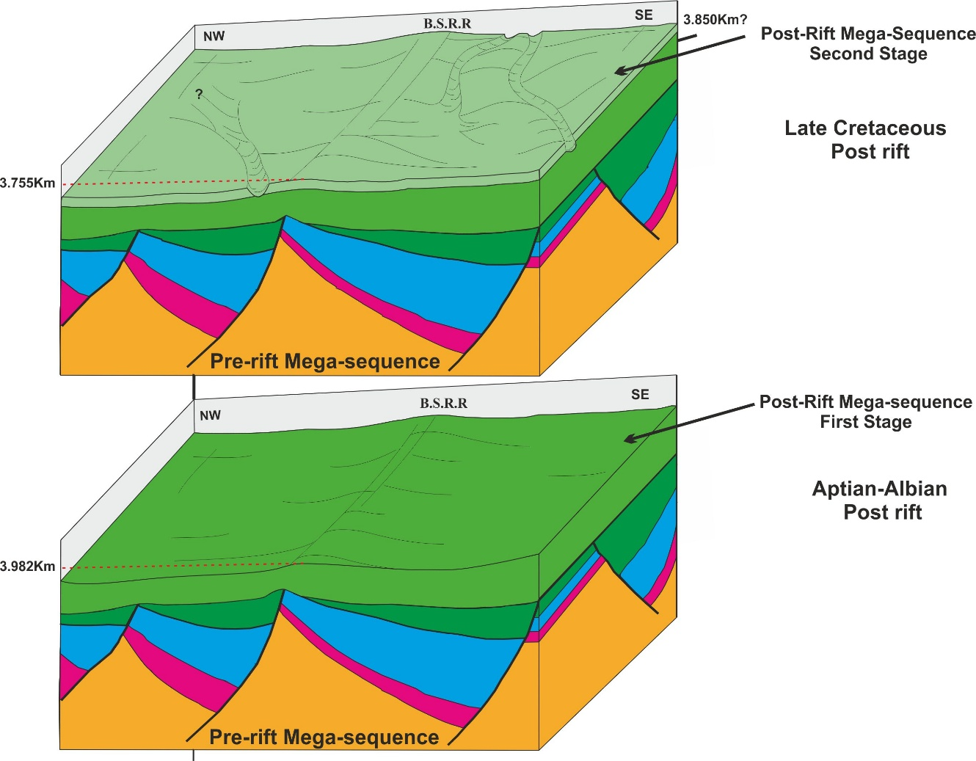
Structural Reconstruction of the AOI
Post-Rift stages
Syn-Rift stages
Unscaled 3D structural model Restoration for the Mesozoic interval of the AOI

Slide 6
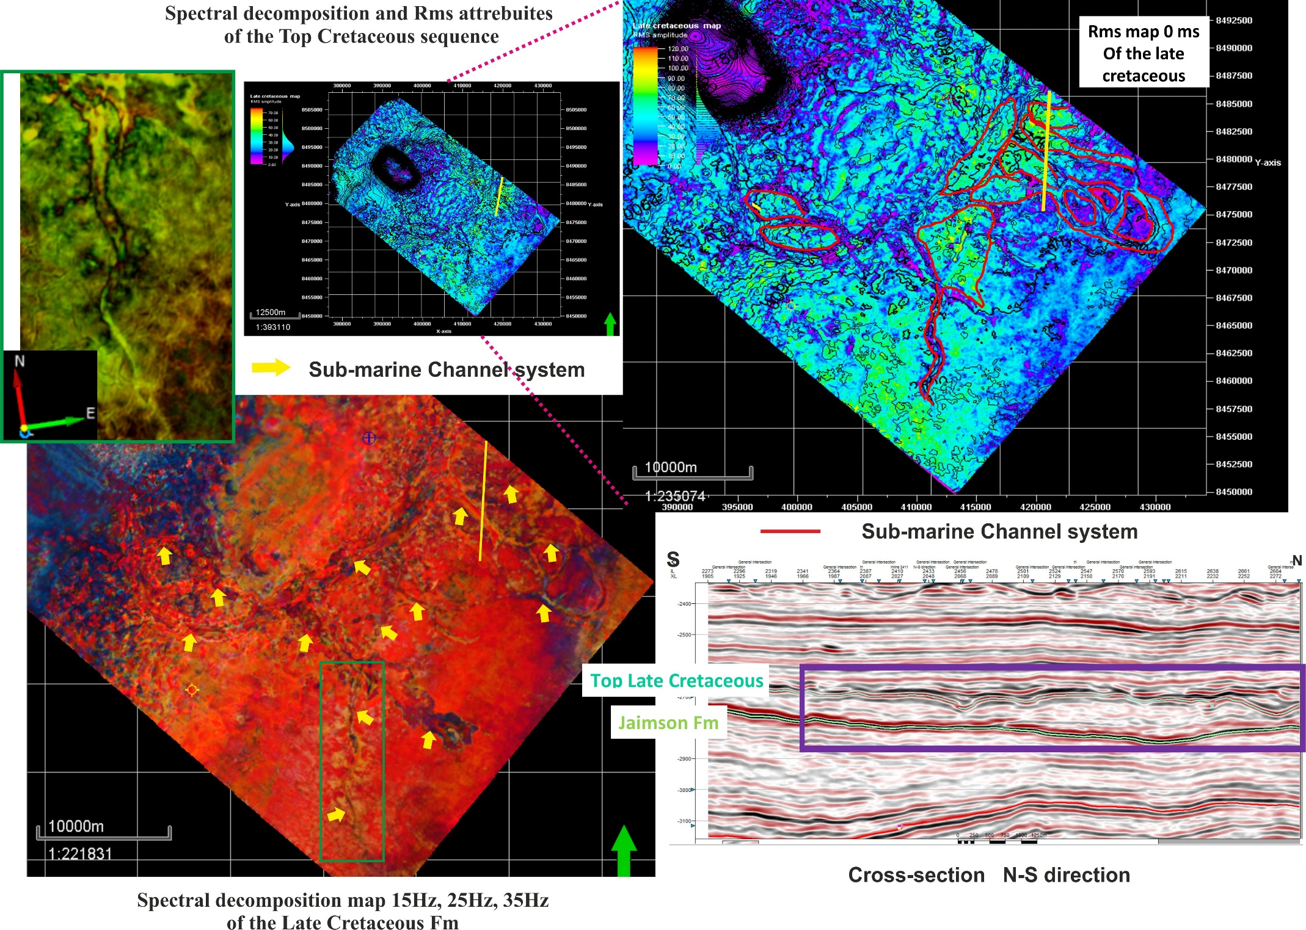
Kronos
Depositional system analysis
Torosa
Spectral decomposition and Rms attributes for the Top Cretaceous map
Kronos
Torosa

Slide 7
Kronos
Depositional system analysis
Torosa
Spectral decomposition and Rms attributes for the Top Cretaceous map
Kronos
Torosa

